Slide 1

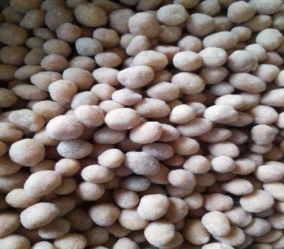
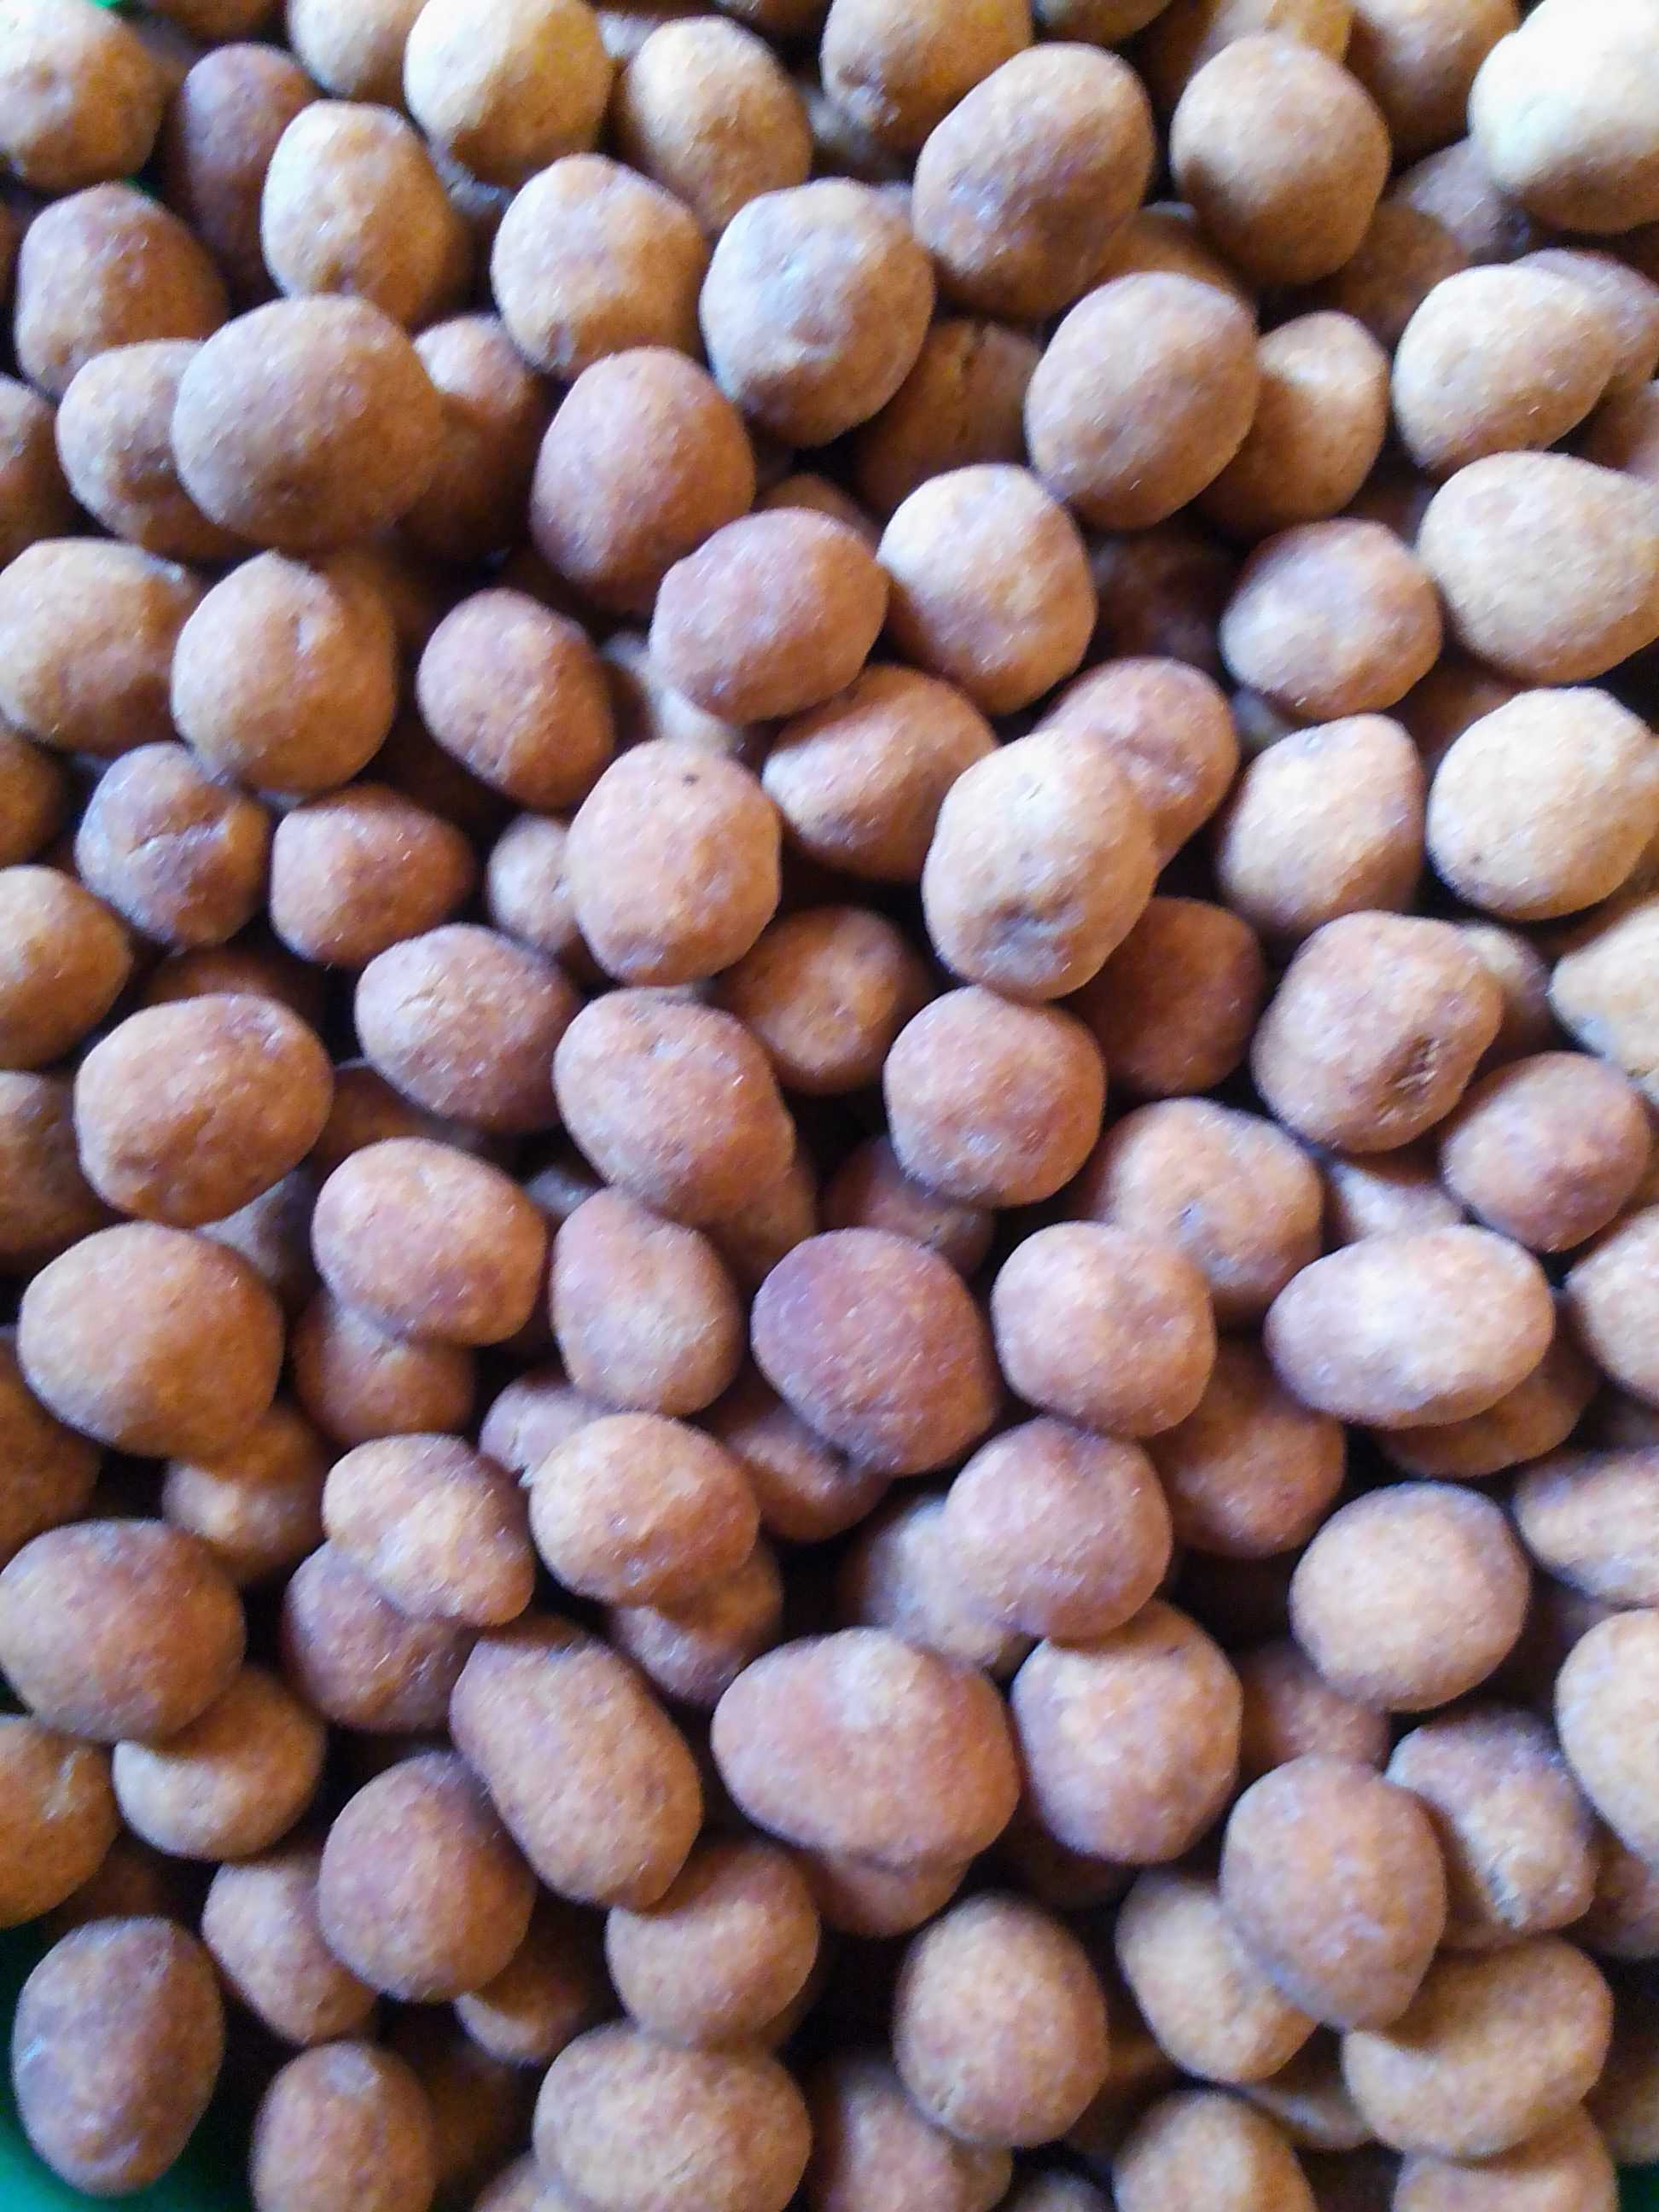
DEBEST VENTURE

Slide 2

Challenges facing snacks production
Economy instability
Inflation
Increment in the price of raw materials

Slide 3
Supplying high quality snacks to shop and household on a cheaper rate
I will achieve this goals by :
Creating awareness campaign in the neighbourhood
getting raw materials directly from the manufactural
Produce snacks in large quantity
Brand my product in a unique format

Slide 4
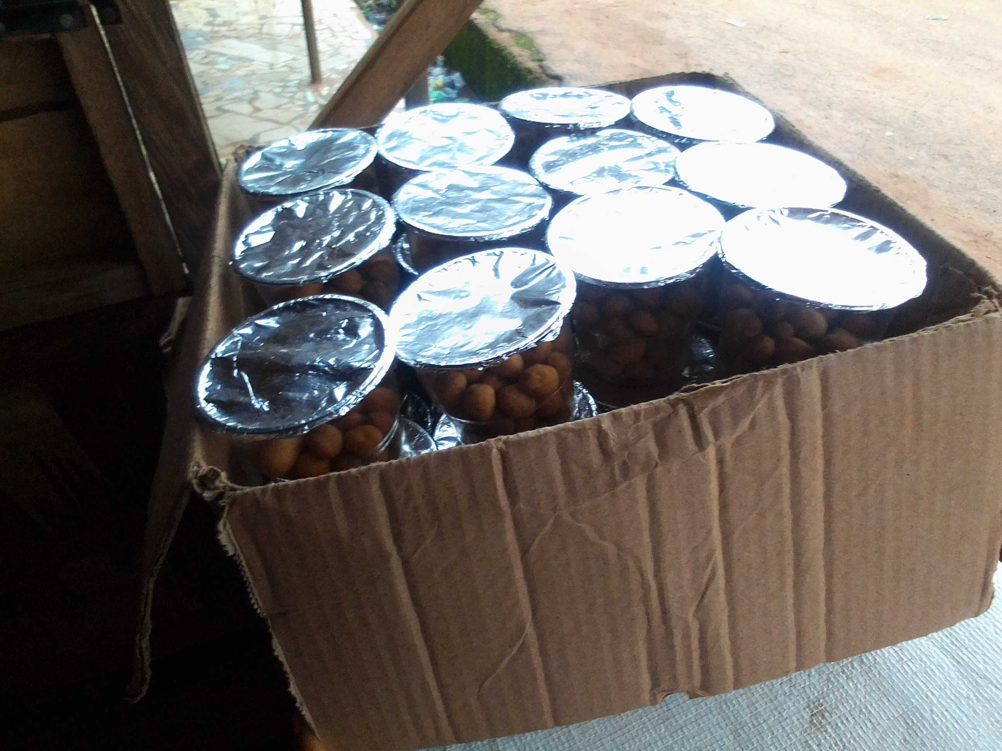
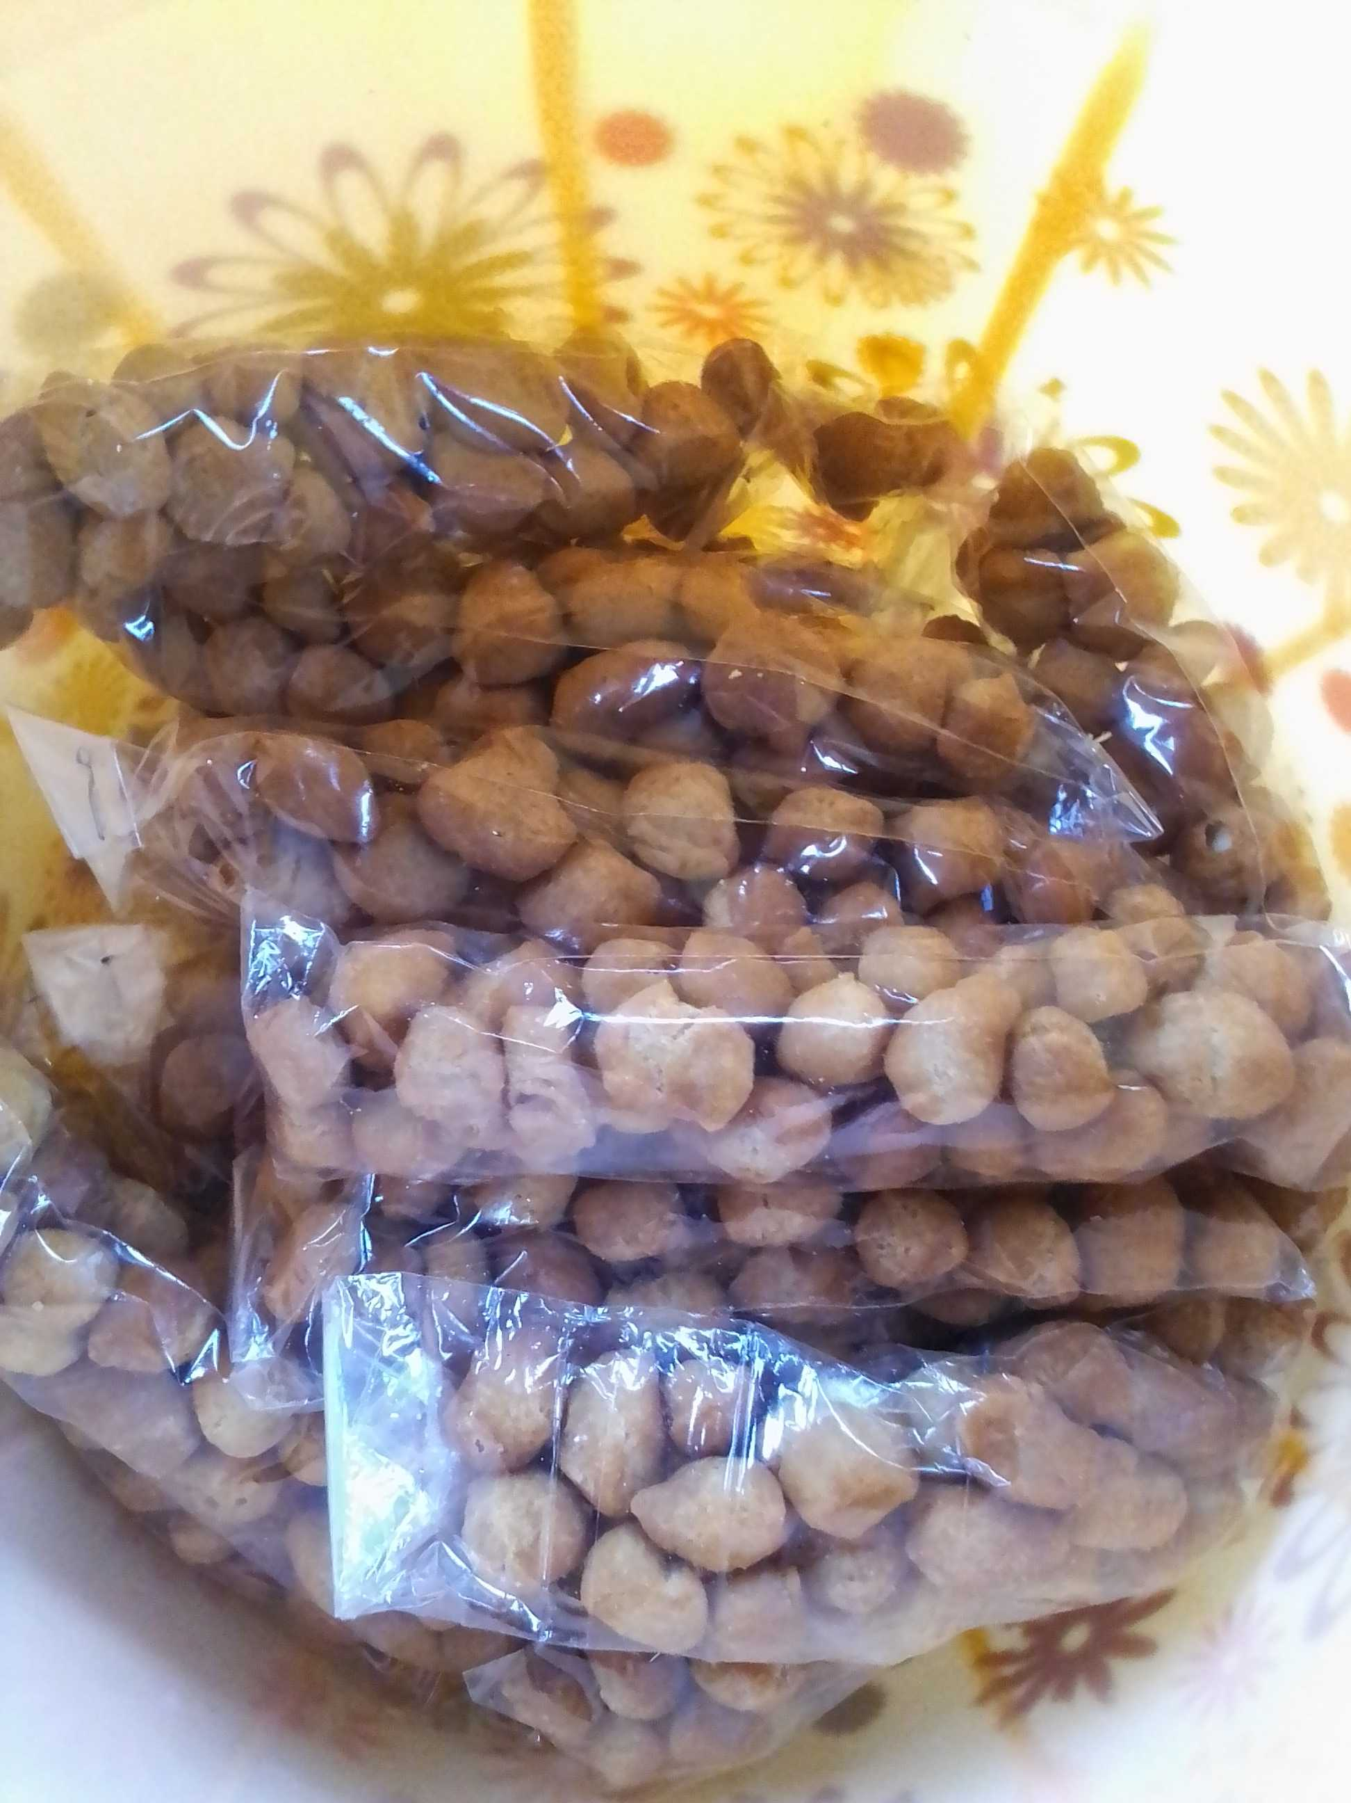
Product
We produce the following
peanut
Cake
Bread
Chin-chin
Meat-pie
Fish-pie
Donut

Slide 5



Target Market
2 out 5
Elaborate on the featured statistic.
95%
Elaborate on the featured statistic.
123 million
Elaborate on the featured statistic.

Slide 6
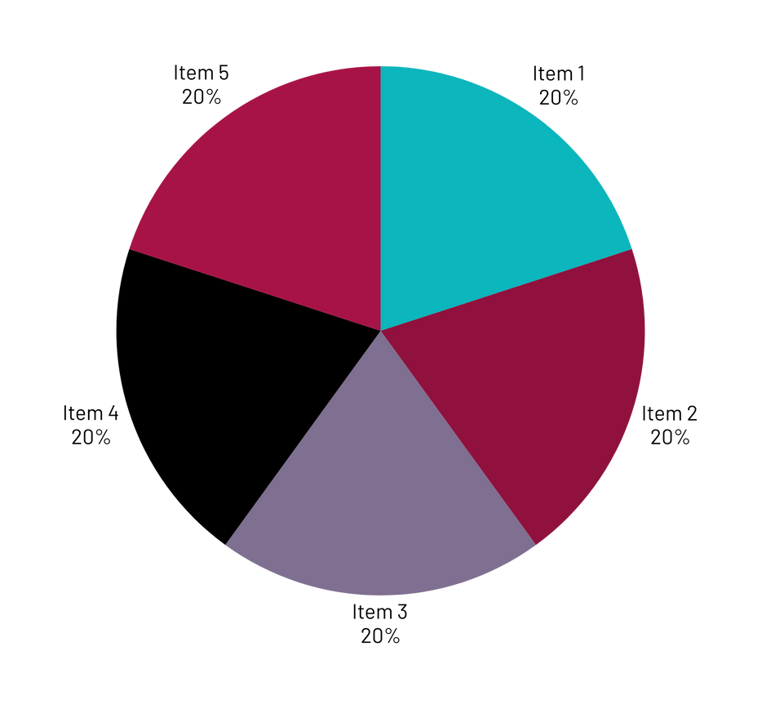
Market Size
Discuss Your market size

Slide 7
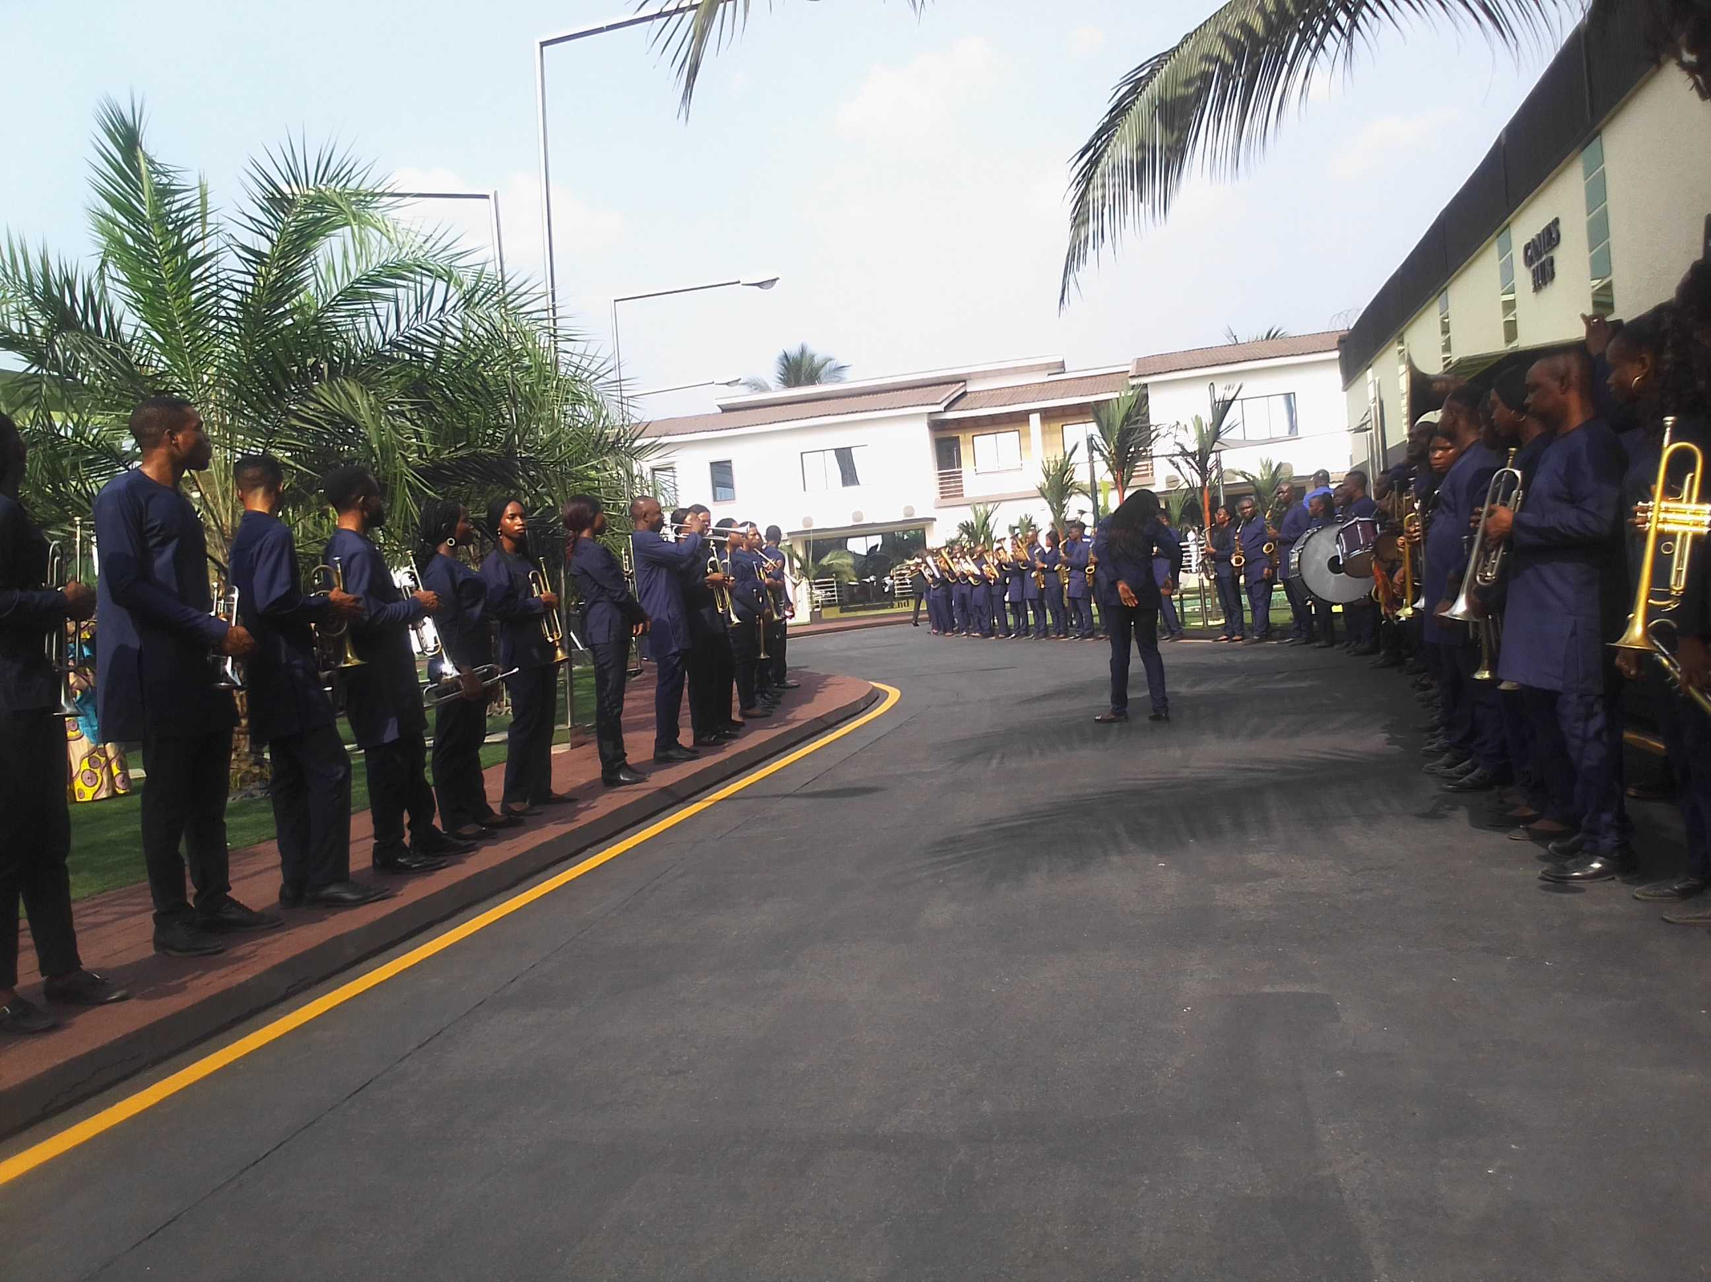
Competitors
Our competitors include
Crunches
Chicken republic
Food affairs
De-choice

Slide 8
Competitive Advantage
We have been able to create familiarity with the local market
Distribution is ongoing in the local shops
We have an online platform were customers orders from us at the comfort of their home
We have a mini eatery were customers get our product, sit and eat in the case where they want to do so.
Seasonal bonanza is been done to our value added customers

Slide 9
Project Traction
Tasks
Month 1
Month 2
Month 3
Month 4
Month 5
Write your task here
Write your task here
Write your task here
Write your task here
Write your task here
Write your task here
Write your task here
Write your task here

Slide 10

Business Model
Currently, we have invested to the business through partnership
We earn fifty thousand naira as annual net profit

Slide 11

Potential customers include
Supermarkets
Gregory shops
Schools
Offices
online audiences

Slide 12
Social Impact
In the cause of the production, the society will benefit the following and more:
High quality but cheap product
Healthy product
The road to the industry will be develop which will be added to the society
Employment opportunity for the citizens
Scholarship opportunity for the citizen
Empowerment programme

Slide 13
Our Ask
Five Million Naira will help to give the business a push to it zenith point.
Two Million for raw materials
One Million for equipment
One Million for Export duties and other expenses for the start
One Million for Miscellaneous

Slide 14



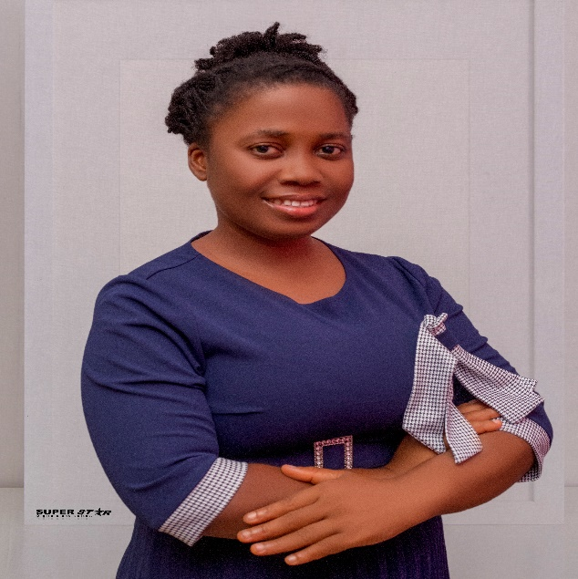
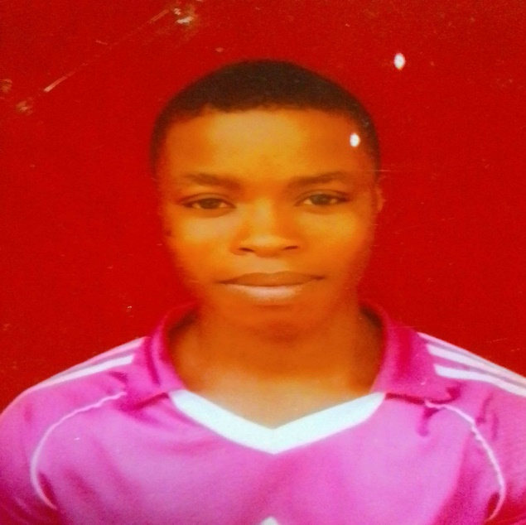
Team Members
Our team members includes
Ebi Janet
Bin@chi
De-best
Sammy Young
Human Resources Manager
Brand Ambassador
Director
Media Manager

Slide 15



Thank you!
Reach out to me using the following contact
+2348061198717 or esitingimaobong@gmail.com

